Slide 1
Student Assistant App: Enhancing Student Life with Effortless Organization
Presented To Dr. Md. Ezharul Islam
Professor
Samsun Nahar Khandakar
Lecturer
Presented By Shanjida Alam
ID: 353
Shabrina Akter Shahana
ID: 2147
Department of Computer Science and Engineering

Slide 2
Table of contents
Introduction
Objectives
Target Audience
Key Features
To-Do Management
Personal Finance Management
Coding Design
Future Work
Conclusion

Slide 3

Introduction
Problem:
Students often struggle to balance academic tasks and personal finances leading to stress and inefficiency.
Solution:
Student-Assistant, a unified app designed to streamline daily organization with task management and finance tracking.
Project Link:
https://github.com/shanjida-alam/Student-Assistant-App
https://github.com/ShabrinaShahana/StudentAssistant
3

Slide 4
Objectives
Simplify task management with TO-DO tools.
Promote financial literacy among students.
Boost productivity with reminders and prioritization.
Provide seamless expense and income tracking.
Combine task and finance management in one app.
4

Slide 5
Target Audience
High School Students:
Managing assignments,
Extracurriculars, and
Personal expenses.
University Students:
Balancing academics,
Part-time jobs, and
Social activities.
Part-Time Working Students:
Managing work schedules alongside studies.
Budget-Conscious Students:
Those aiming to improve financial discipline and savings.
5

Slide 6
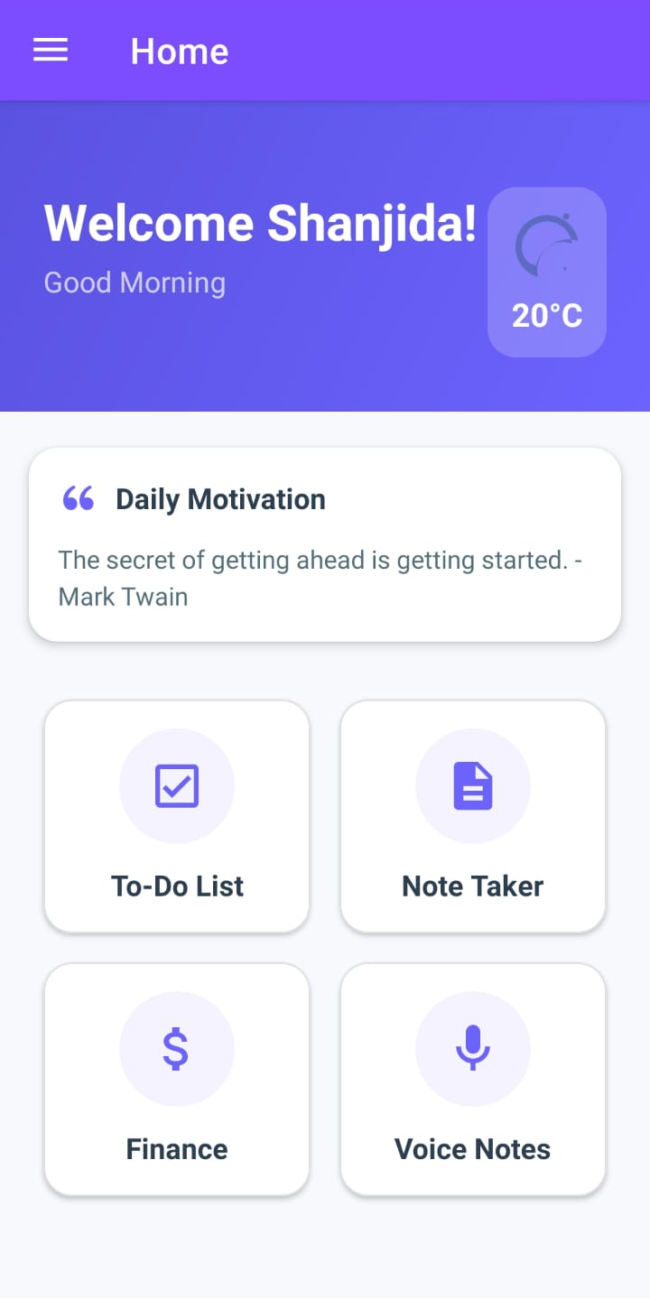
Key Features
1. TO-DO Management
Prioritize and track tasks efficiently.
Set reminders for deadlines.
Categorize tasks for better organization.
2. Personal Finance Management
Track expenses and manage budgets.
Set savings goals and monitor progress.
Generate spending analysis reports.
6

Slide 7
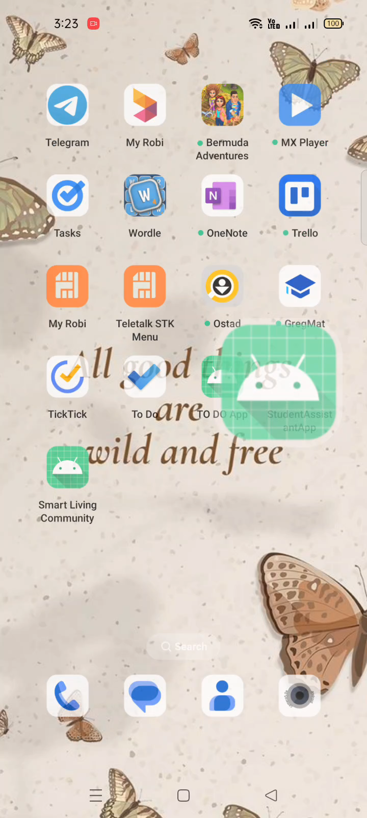
Demo Video
7

Slide 8
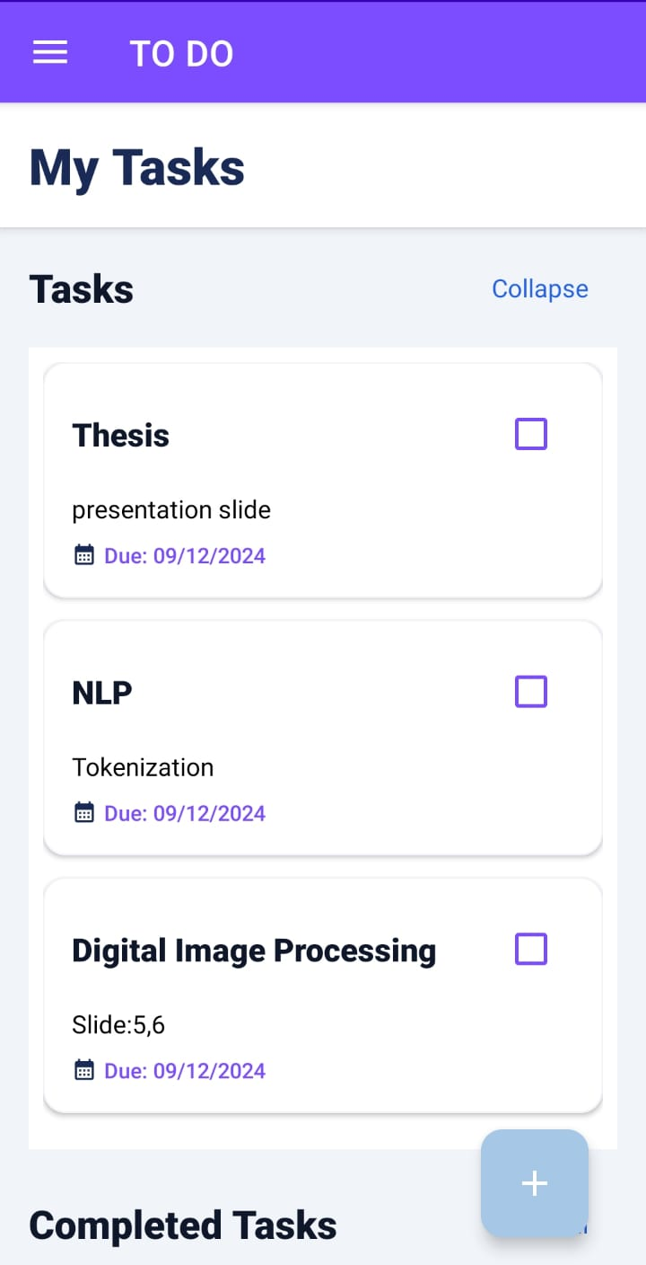
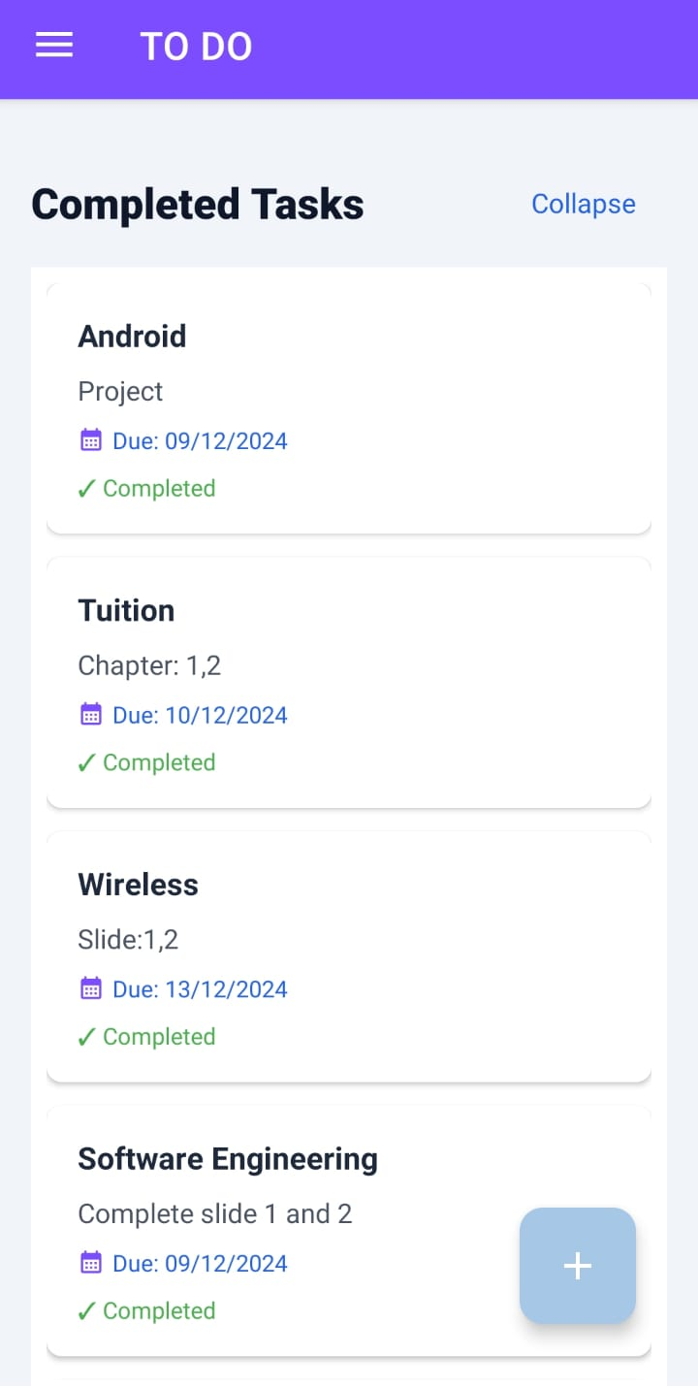
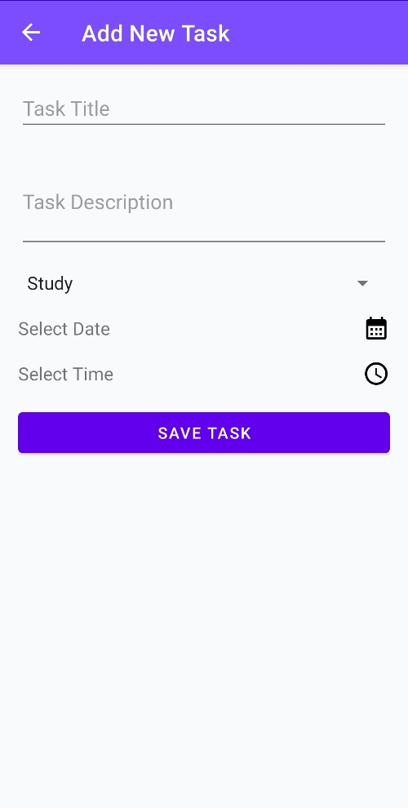
To-Do Management
Fig 1: Task List
Fig 3: Add New Task
8
Fig 2: Completed Task List

Slide 9
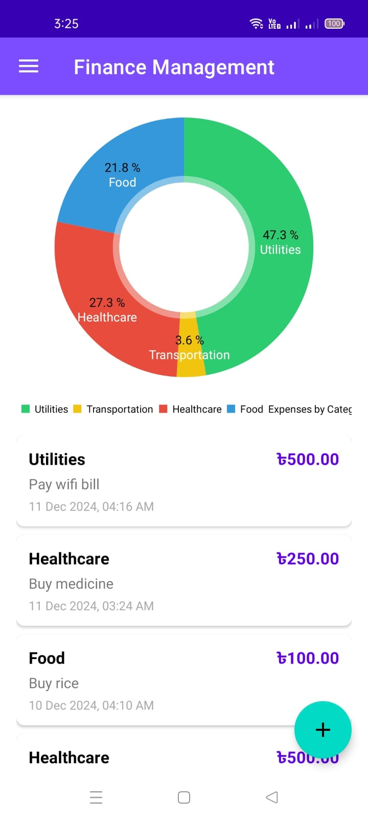
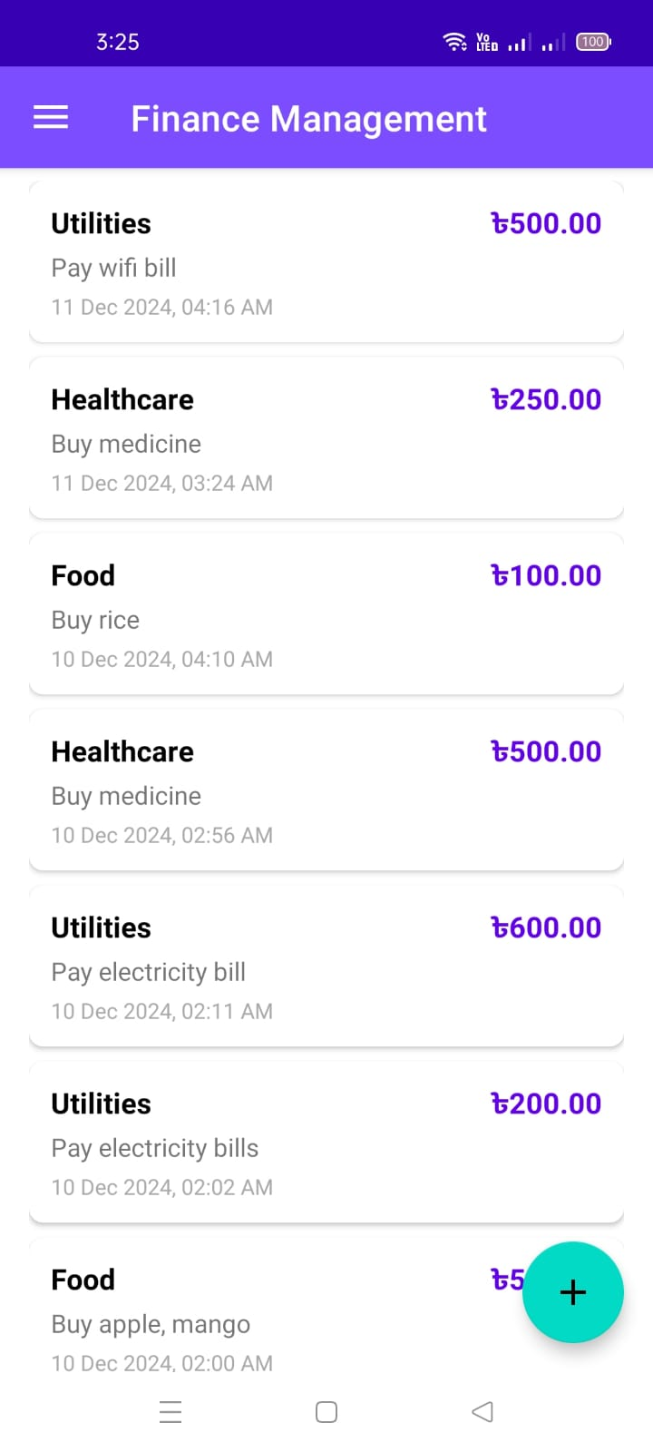
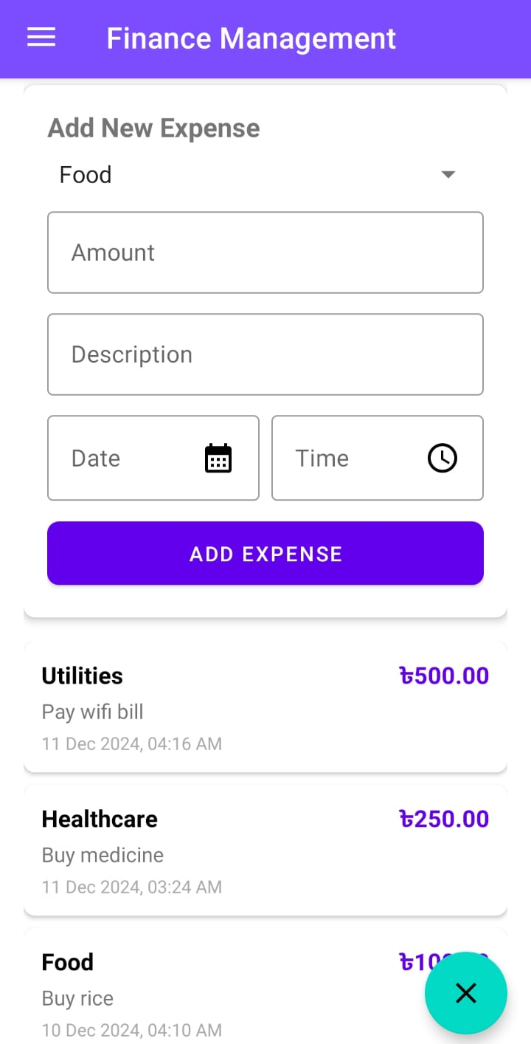
Personal Finance Management
Fig 4: Expense Breakdown Pie Chart
Fig 5: Expense Details
Fig 6:Add New Expense
9

Slide 10
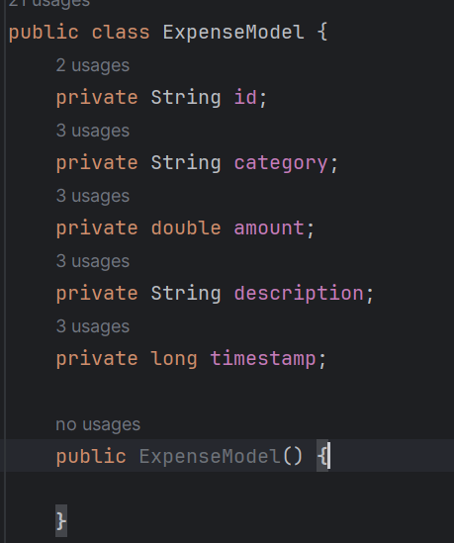
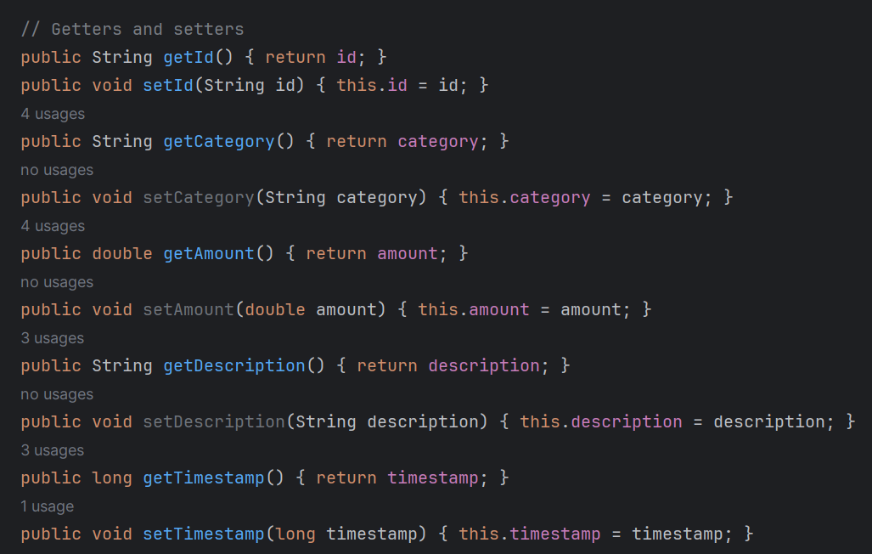
Coding Design
Single Responsibility Principle
10

Slide 11
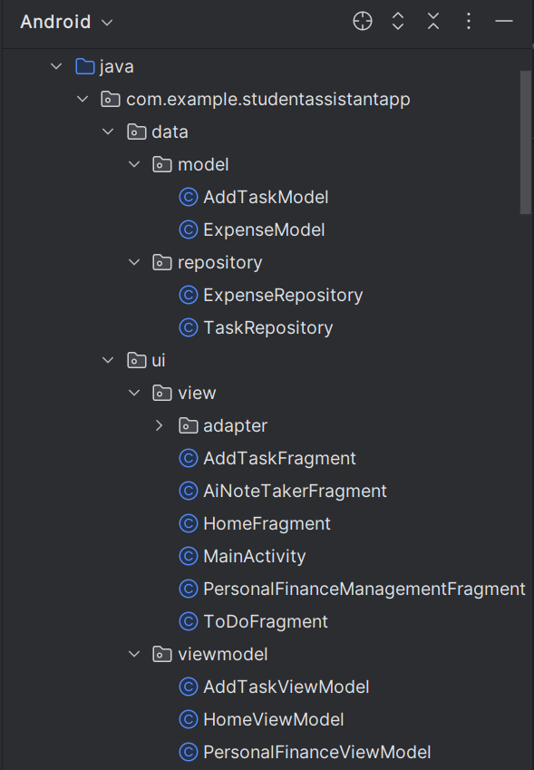
Coding Design Continue
MVVM Architecture
11

Slide 12
Conclusion
Planned extensions:
University system integration (e.g., LMS, Google Calendar).
Collaborative tools for group work.
To add, an AI note-taker allows students to input an image or voice recording. The AI extracts text from the image or voice and then generates a summary based on the extracted content.
Empower students to:
Stay organized effortlessly.
Achieve financial independence.
Focus on what truly matters.
12

Slide 13

Any Questions

Slide 14


